Slide 1
The Rise of Global Authoritarianism
Lawrence W. Hua
Master of Information System Management

Slide 2
What is Authoritarianism?
Believing that people should obey authority and rules, even when these are unfair, and even if it means that they lose their personal freedom

Slide 3
Prompt 1
Can you give me evidence on the global rise of authoritarianism?

Slide 4
Response 1
Gives evidence and trends that indicate a rise.

Slide 5
Response 1
Erosion of Democratic Institutions
Restrictions on Freedom of Speech and Press
Human Rights Violations
Rise of Populist Movements
Democratic Backsliding
Global Shift in Power Dynamics
Increased Authoritarian Leaderships

Slide 6
Prompt 2
Is authoritarianism a good thing or a bad thing for humankind?

Slide 7
Response 2
It could have positive and negative effects, up to one’s values to decide.

Slide 8
Positives
1) Efficiency and Stability
2) Economic Development
3) Social Order

Slide 9
Negatives
1) Violation of Human Rights
2) Lack of Accountability
3) Stifled Innovation and Creativity
4) Social Inequality

Slide 10

Ultimately…
Human rights, democracy, and overall societal well-being
Stability & Efficiency

Slide 11
From my own research…

Slide 12
Prompt 1 Revamp
Can you give me evidence on the global rise of authoritarianism?

Slide 13
From Standford, we can narrow down to 3 trends…
Excess globalization, capitalism, exploding inequality
National purpose
(9/11)
Technology
(misinfo)

Slide 14
Prompt 2 Revamp
Is authoritarianism a good thing or a bad thing for humankind?

Slide 15
What is good/bad for humankind?
Meaning of life:
Significance (Life and contributions matter to society),
Purpose (Has valued goals)
Coherence or comprehensibility (Life just make sense)
Mood:
Happy
Sad

Slide 16
National Library of Medicine Study
Study: Participants were told to listen to a variety of speeches (Egalitarian/control/authoritarian)
Outcome:
Exposure to authoritarian speeches led to worse mood and negative evaluations, but higher meaning in life than a control perspective.

Slide 17
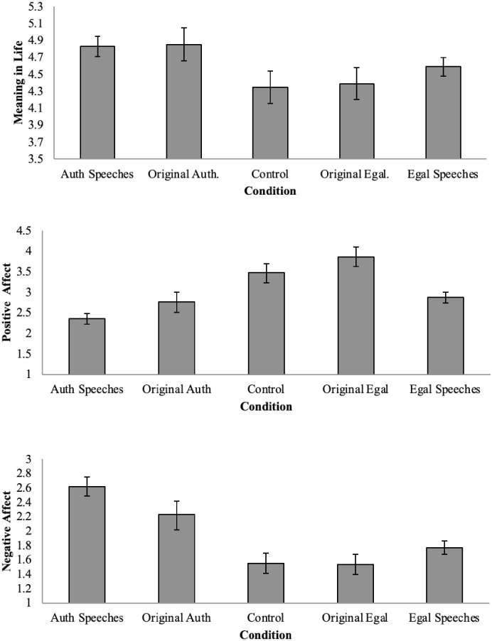
Study Chart
Higher than control
Lower than control
Higher than control

Slide 18
Differences in responses

Slide 19
Differences in response, prompt 1:
evidence on the global rise of authoritarianism
Chat GPT: Definitive/General Erosion of Democratic Institutions
Increased Authoritarian Leaderships
Restrictions on Freedom of Speech and Press
Human Rights Violations
Rise of Populist Movements
Democratic Backsliding
Global Shift in Power Dynamics
Lawrence’s research: Biased
Excess globalization, capitalism, exploding inequality
National purpose (9/11)
Technology(misinfo)
Pandemic

Slide 20
Differences in response, prompt 2:
Is authoritarianism good or bad for humans?
Lawrence’s research: grey
Depends on:
Does mood dictate a happy life? Or does purpose?
Conclusion:
Needs a balance! Up to a certain degree is ok.
Chat GPT: B/W Depends, either have:
Stability and Efficiency
Or:
Human rights
Democracy
Societal well being
Conclusion:
Up to the human to decide

Slide 21
References
Authoritarianism noun - definition, pictures, pronunciation and ... (n.d.). https://www.oxfordlearnersdictionaries.com/definition/english/authoritarianism
The global rise of authoritarianism. Economic and Political Weekly. (2023, February 23). https://www.epw.in/engage/article/global-rise-authoritarianism
Morgan, M. (n.d.). Understanding the global rise of authoritarianism. FSI. https://fsi.stanford.edu/news/understanding-global-rise-authoritarianism
University of North carolina, University of Missouri, University of Illinois urbana champaign, & Reed College. (2021, September). Exposure to authoritarian values leads to lower positive affect, higher negative affect, and higher meaning in life . Exposure to authoritarian values leads to lower positive affect, higher negative affect, and higher meaning in life. https://www.ncbi.nlm.nih.gov/pmc/articles/PMC8443031/

